Slide 1
Software Engineering Practice
Software engineering practice
Communication practices
Planning practices
Analysis modeling practices
Design modeling practices
Construction practices
Deployment practices
(Source: Pressman, R. Software Engineering: A Practitioner’s Approach. McGraw-Hill, 2005)

Slide 2
Software Engineering Practice
Consists of a collection of concepts, principles, methods, and tools that a software engineer calls upon on a daily basis
Equips managers to manage software projects and software engineers to build computer programs
Provides necessary technical and management how to’s in getting the job done
Transforms a haphazard unfocused approach into something that is more organized, more effective, and more likely to achieve success

Slide 3
The Essence of Problem Solving
Understand the problem (communication and analysis)
Who has a stake in the solution to the problem?
What are the unknowns (data, function, behavior)?
Can the problem be compartmentalized?
Can the problem be represented graphically?
Plan a solution (planning, modeling and software design)
Have you seen similar problems like this before?
Has a similar problem been solved and is the solution reusable?
Can subproblems be defined and are solutions available for the subproblems?
(more on next slide)

Slide 4
The Essence of Problem Solving (continued)
Carry out the plan (construction; code generation)
Does the solution conform to the plan? Is the source code traceable back to the design?
Is each component of the solution correct? Has the design and code been reviewed?
Examine the results for accuracy (testing and quality assurance)
Is it possible to test each component of the solution?
Does the solution produce results that conform to the data, function, and behavior that are required?

Slide 5
Seven Core Principles for Software Engineering
Remember the reason that the software exists
The software should provide value to its users and satisfy the requirements
Keep it simple
All design and implementation should be as simple as possible
Maintain the vision of the project
A clear vision is essential to the project’s success
Others will consume what you produce
Always specify, design, and implement knowing that someone else will later have to understand and modify what you did
Be open to the future
Never design yourself into a corner; build software that can be easily changed and adapted
Plan ahead for software reuse
Reuse of software reduces the long-term cost and increases the value of the program and the reusable components
Think, then act
Placing clear, complete thought before action will almost always produce better results

Slide 6
Communication Practices (Requirements Elicitation)
Communication
Project initiation
Requirements gathering
Planning
Estimating
Scheduling
Tracking
Modeling
Analysis
Design
Construction
Code
Test
Deployment
Delivery
Support
Feedback
6

Slide 7
Communication Principles
Listen to the speaker and concentrate on what is being said
Prepare before you meet by researching and understanding the problem
Someone should facility the meeting and have an agenda
Face-to-face communication is best, but also have a document or presentation to focus the discussion
Take notes and document decisions
Strive for collaboration and consensus
Stay focused on a topic; modularize your discussion
If something is unclear, draw a picture
Move on to the next topic a) after you agree to something, b) if you cannot agree to something, or c) if a feature or function is unclear and cannot be clarified at the moment
Negotiation is not a contest or a game; it works best when both parties win

Slide 8
Planning Practices (Defining a Road Map)
Communication
Project initiation
Requirements gathering
Planning
Estimating
Scheduling
Tracking
Modeling
Analysis
Design
Construction
Code
Test
Deployment
Delivery
Support
Feedback
8

Slide 9
Planning Principles
Understand the scope of the project
Involve the customer in the planning activity
Recognize that planning is iterative; things will change
Estimate based only on what you know
Consider risk as you define the plan
Be realistic on how much can be done each day by each person and how well
Adjust granularity as you define the plan
Define how you intend to ensure quality
Describe how you intend to accommodate change
Track the plan frequently and make adjustments as required

Slide 10
Barry Boehm’s W⁵HH Principle
Why is the system being developed?
What will be done?
When will it be accomplished?
Who is responsible for each function?
Where are they organizationally located?
How will the job be done technically and managerially?
How much of each resource is needed?
The answers to these questions lead to a definition of key
project characteristics and the resultant project plan

Slide 11
Modeling Practices (Analysis and Design)
Communication
Project initiation
Requirements gathering
Planning
Estimating
Scheduling
Tracking
Modeling
Analysis
Design
Construction
Code
Test
Deployment
Delivery
Support
Feedback
11

Slide 12
Analysis Modeling Principles
The information domain of a problem (the data that flows in and out of a system) must be represented and understood
The functions that the software performs must be defined
The behavior of the software (as a consequence of external events) must be represented
The models that depict information, function, and behavior must be partitioned in a manner that uncovers detail in a layered (or hierarchical) fashion
The analysis task should move from essential information toward implementation detail

Slide 13
Design Modeling Principles
The design should be traceable to the analysis model
Always consider the software architecture of the system to be built
Design of data is as important as design of processing functions
Interfaces (both internal and external) must be designed with care
User interface design should be tuned to the needs of the end-user and should stress ease of use
Component-level design should be functionally independent (high cohesion)
Components should be loosely coupled to one another and to the external environment
Design representations (models) should be easily understandable
The design should be developed iteratively; with each iteration, the designer should strive for greater simplicity
External quality factors: those properties that can be readily observed
Internal quality factors: those properties that lead to a high-quality design from a technical perspective

Slide 14
Construction Practices
Communication
Project initiation
Requirements gathering
Planning
Estimating
Scheduling
Tracking
Modeling
Analysis
Design
Construction
Code
Test
Deployment
Delivery
Support
Feedback
14

Slide 15
Coding Principles (Preparation before coding)
Understand the problem you are trying to solve
Understand basic design principles and concepts
Pick a programming language that meets the needs of the software to be built and the environment in which it will operate
Select a programming environment that provides tools that will make your work easier
Create a set of unit tests that will be applied once the component you code is completed

Slide 16
Coding Principles (As you begin coding)
Constrain your algorithms by following structured programming practices
Select data structures that will meet the needs of the design
Understand the software architecture and create interfaces that are consistent with it
Keep conditional logic as simple as possible
Create nested loops in a way that makes them easily testable
Select meaningful variable names and follow other local coding standards
Write code that is self-documenting
Create a visual layout (e.g., indentation and blank lines) that aids code understanding

Slide 17
Coding Principles (After completing the first round of code)
Conduct a code walkthrough
Perform unit tests (black-box and white-box) and correct errors you have uncovered
Refactor the code

Slide 18
Testing Principles
All tests should be traceable to the software requirements
Tests should be planned long before testing begins
The Pareto principle applies to software testing
80% of the uncovered errors are in 20% of the code
Testing should begin “in the small” and progress toward testing “in the large”
Unit testing --> integration testing --> validation testing --> system testing
Exhaustive testing is not possible

Slide 19
Test Objectives
Testing is a process of executing a program with the intent of finding an error
A good test case is one that has a high probability of finding an as-yet undiscovered error
A successful test is one that uncovers an as-yet undiscovered error

Slide 20
Deployment Practices
Communication
Project initiation
Requirements gathering
Planning
Estimating
Scheduling
Tracking
Modeling
Analysis
Design
Construction
Code
Test
Deployment
Delivery
Support
Feedback
20

Slide 21
Deployment Principles
Customer expectations for the software must be managed
Be careful not to promise too much or to mislead the user
A complete delivery package should be assembled and tested
A support regime must be established before the software is delivered
Appropriate instructional materials must be provided to end users
Buggy software should be fixed first, delivered later
☺

Slide 22
Requirements Engineering
Problems with requirements practices
Requirements engineering tasks
Inception
Elicitation
Elaboration
Negotiation
Specification
Validation
Requirements management
(Source: Pressman, R. Software Engineering: A Practitioner’s Approach. McGraw-Hill, 2005)

Slide 23
The Problems with our Requirements Practices
We have trouble understanding the requirements that we do acquire from the customer
We often record requirements in a disorganized manner
We spend far too little time verifying what we do record
We allow change to control us, rather than establishing mechanisms to control change
Most importantly, we fail to establish a solid foundation for the system or software that the user wants built
(more on next slide)

Slide 24
The Problems with our Requirements Practices (continued)
Many software developers argue that
Building software is so compelling that we want to jump right in (before having a clear understanding of what is needed)
Things will become clear as we build the software
Project stakeholders will be able to better understand what they need only after examining early iterations of the software
Things change so rapidly that requirements engineering is a waste of time
The bottom line is producing a working program and that all else is secondary
All of these arguments contain some truth, especially for small projects that take less than one month to complete
However, as software grows in size and complexity, these arguments begin to break down and can lead to a failed software project

Slide 25
Requirement Engineering & Management
Feasibility Study
Requirement Gathering
Software Requirement Specification
Software Requirement Validation

Slide 26
Software Requirements Characteristics
Gathering software requirements is the foundation of the entire software development project. Hence they must be clear, correct and well-defined.
Clear Correct Consistent Coherent (Logical & Consistent) Traceable Credible source | Comprehensible Modifiable Verifiable Prioritized Unambiguous

Slide 27
Requirements are categorized logically as
Must Have : Software cannot be said operational without them.
Should have : Enhancing the functionality of software.
Could have : Software can still properly function with these requirements.
Wish list : These requirements do not map to any objectives of software.

Slide 28
A Solution: Requirements Engineering
Begins during the communication activity and continues into the modeling activity
Builds a bridge from the system requirements into software design and construction
Allows the requirements engineer to examine
the context of the software work to be performed
the specific needs that design and construction must address
the priorities that guide the order in which work is to be completed
the information, function, and behavior that will have a profound impact on the resultant design

Slide 29
Requirements Engineering Tasks
Seven distinct tasks
Inception
Elicitation
Elaboration
Negotiation
Specification
Validation
Requirements Management
Some of these tasks may occur in parallel and all are adapted to the needs of the project
All strive to define what the customer wants
All serve to establish a solid foundation for the design and construction of the software

Slide 30
Example Project: Campus Information Access Kiosk
Both podium-high and desk-high terminals located throughout the campus in all classroom buildings, admin buildings, labs, and dormitories
Hand/Palm-login and logout (seamlessly)
Voice input
Optional audio/visual or just visual output
Immediate access to all campus information plus
E-mail
Cell phone voice messaging

Slide 31
Inception
Elicitation
Elaboration
Negotiation
Specification
Validation
Requirements
Management

Slide 32
Inception Task
During inception, the requirements engineer asks a set of questions to establish…
A basic understanding of the problem
The people who want a solution
The nature of the solution that is desired
The effectiveness of preliminary communication and collaboration between the customer and the developer
Through these questions, the requirements engineer needs to…
Identify the stakeholders
Recognize multiple viewpoints
Work toward collaboration
Break the ice and initiate the communication

Slide 33
The First Set of Questions
These questions focus on the customer, other stakeholders, the overall goals, and the benefits
Who is behind the request for this work?
Who will use the solution?
What will be the economic benefit of a successful solution?
Is there another source for the solution that you need?

Slide 34
The Next Set of Questions
These questions enable the requirements engineer to gain a better understanding of the problem and allow the customer to voice his or her perceptions about a solution
How would you characterize "good" output that would be generated by a successful solution?
What problem(s) will this solution address?
Can you show me (or describe) the business environment in which the solution will be used?
Will special performance issues or constraints affect the way the solution is approached?

Slide 35
The Final Set of Questions
These questions focus on the effectiveness of the communication activity itself
Are you the right person to answer these questions? Are your answers "official"?
Are my questions relevant to the problem that you have?
Am I asking too many questions?
Can anyone else provide additional information?
Should I be asking you anything else?

Slide 36
Inception
Elicitation
Elaboration
Negotiation
Specification
Validation
Requirements
Management

Slide 37
Elicitation Task
Eliciting requirements is difficult because of
Problems of scope in identifying the boundaries of the system or specifying too much technical detail rather than overall system objectives
Problems of understanding what is wanted, what the problem domain is, and what the computing environment can handle (Information that is believed to be "obvious" is often omitted)
Problems of volatility because the requirements change over time
Elicitation may be accomplished through two activities
Collaborative requirements gathering
Quality function deployment

Slide 38
Basic Guidelines of Collaborative Requirements Gathering
Meetings are conducted and attended by both software engineers, customers, and other interested stakeholders
Rules for preparation and participation are established
An agenda is suggested that is formal enough to cover all important points but informal enough to encourage the free flow of ideas
A "facilitator" (customer, developer, or outsider) controls the meeting
A "definition mechanism" is used such as work sheets, flip charts, wall stickers, electronic bulletin board, chat room, or some other virtual forum
The goal is to identify the problem, propose elements of the solution, negotiate different approaches, and specify a preliminary set of solution requirements

Slide 39
Quality Function Deployment
This is a technique that translates the needs of the customer into technical requirements for software
It emphasizes an understanding of what is valuable to the customer and then deploys these values throughout the engineering process through functions, information, and tasks
It identifies three types of requirements
Normal requirements: These requirements are the objectives and goals stated for a product or system during meetings with the customer
Expected requirements: These requirements are implicit to the product or system and may be so fundamental that the customer does not explicitly state them
Exciting requirements: These requirements are for features that go beyond the customer's expectations and prove to be very satisfying when present

Slide 40
Requirement Elicitation Techniques
Interviews
Surveys
Questionnaires
Task analysis
Domain Analysis
Brainstorming
Prototyping
Observation

Slide 41
Elicitation Work Products
The work products will vary depending on the system, but should include one or more of the following items
A statement of need and feasibility
A bounded statement of scope for the system or product
A list of customers, users, and other stakeholders who participated in requirements elicitation
A description of the system's technical environment
A list of requirements (organized by function) and the domain constraints that apply to each
A set of preliminary usage scenarios (in the form of use cases) that provide insight into the use of the system or product under different operating conditions
Any prototypes developed to better define requirements

Slide 42
Inception
Elicitation
Elaboration
Negotiation
Specification
Validation
Requirements
Management

Slide 43
Elaboration Task
During elaboration, the software engineer takes the information obtained during inception and elicitation and begins to expand and refine it
Elaboration focuses on developing a refined technical model of software functions, features, and constraints
It is an analysis modeling task
Use cases are developed
Domain classes are identified along with their attributes and relationships
State machine diagrams are used to capture the life on an object
The end result is an analysis model that defines the functional, informational, and behavioral domains of the problem

Slide 44
Developing Use Cases
Step One – Define the set of actors that will be involved in the story
Actors are people, devices, or other systems that use the system or product within the context of the function and behavior that is to be described
Actors are anything that communicate with the system or product and that are external to the system itself
Step Two – Develop use cases, where each one answers a set of questions
(More on next slide)

Slide 45
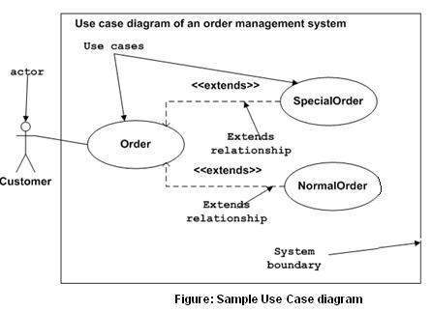

Slide 46
Questions Commonly Answered by a Use Case
Who is the primary actor(s), the secondary actor(s)?
What are the actor’s goals?
What preconditions should exist before the scenario begins?
What main tasks or functions are performed by the actor?
What exceptions might be considered as the scenario is described?
What variations in the actor’s interaction are possible?
What system information will the actor acquire, produce, or change?
Will the actor have to inform the system about changes in the external environment?
What information does the actor desire from the system?
Does the actor wish to be informed about unexpected changes?

Slide 47
Elements of the Analysis Model
Scenario-based elements
Describe the system from the user's point of view using scenarios that are depicted in use cases and activity diagrams
Class-based elements
Identify the domain classes for the objects manipulated by the actors, the attributes of these classes, and how they interact with one another; they utilize class diagrams to do this
Behavioral elements
Use state diagrams to represent the state of the system, the events that cause the system to change state, and the actions that are taken as a result of a particular event; can also be applied to each class in the system
Flow-oriented elements
Use data flow diagrams to show the input data that comes into a system, what functions are applied to that data to do transformations, and what resulting output data are produced

Slide 48
Inception
Elicitation
Elaboration
Negotiation
Specification
Validation
Requirements
Management

Slide 49
Negotiation Task
During negotiation, the software engineer reconciles the conflicts between what the customer wants and what can be achieved given limited business resources
Requirements are ranked (i.e., prioritized) by the customers, users, and other stakeholders
Risks associated with each requirement are identified and analyzed
Rough guesses of development effort are made and used to assess the impact of each requirement on project cost and delivery time
Using an iterative approach, requirements are eliminated, combined and/or modified so that each party achieves some measure of satisfaction

Slide 50
The Art of Negotiation
Recognize that it is not competition
Map out a strategy
Listen actively
Focus on the other party’s interests
Don’t let it get personal
Be creative
Be ready to commit

Slide 51
Inception
Elicitation
Elaboration
Negotiation
Specification
Validation
Requirements
Management

Slide 52
Specification Task
A specification is the final work product produced by the requirements engineer
It is normally in the form of a software requirements specification
It serves as the foundation for subsequent software engineering activities
It describes the function and performance of a computer-based system and the constraints that will govern its development
It formalizes the informational, functional, and behavioral requirements of the proposed software in both a graphical and textual format

Slide 53
Typical Contents of a Software Requirements Specification
Requirements
Required states and modes
Software requirements grouped by capabilities (i.e., functions, objects)
Software external interface requirements
Software internal interface requirements
Software internal data requirements
Other software requirements (safety, security, privacy, environment, hardware, software, communications, quality, personnel, training, logistics, etc.)
Design and implementation constraints
Qualification provisions to ensure each requirement has been met
Demonstration, test, analysis, inspection, etc.
Requirements traceability
Trace back to the system or subsystem where each requirement applies

Slide 54
Inception
Elicitation
Elaboration
Negotiation
Specification
Validation
Requirements
Management

Slide 55
Validation Task
During validation, the work products produced as a result of requirements engineering are assessed for quality
The specification is examined to ensure that
all software requirements have been stated unambiguously
inconsistencies, omissions, and errors have been detected and corrected
the work products conform to the standards established for the process, the project, and the product
The formal technical review serves as the primary requirements validation mechanism
Members include software engineers, customers, users, and other stakeholders

Slide 56
Questions to ask when Validating Requirements
Is each requirement consistent with the overall objective for the system/product?
Have all requirements been specified at the proper level of abstraction? That is, do some requirements provide a level of technical detail that is inappropriate at this stage?
Is the requirement really necessary or does it represent an add-on feature that may not be essential to the objective of the system?
Is each requirement bounded and unambiguous?
Does each requirement have attribution? That is, is a source (generally, a specific individual) noted for each requirement?
(more on next slide)

Slide 57
Questions to ask when Validating Requirements (continued)
Do any requirements conflict with other requirements?
Is each requirement achievable in the technical environment that will house the system or product?
Is each requirement testable, once implemented?
Approaches: Demonstration, actual test, analysis, or inspection
Does the requirements model properly reflect the information, function, and behavior of the system to be built?
Has the requirements model been “partitioned” in a way that exposes progressively more detailed information about the system?

Slide 58
Inception
Elicitation
Elaboration
Negotiation
Specification
Validation
Requirements
Management

Slide 59
Requirements Management Task
During requirements management, the project team performs a set of activities to identify, control, and track requirements and changes to the requirements at any time as the project proceeds
Each requirement is assigned a unique identifier
The requirements are then placed into one or more traceability tables
These tables may be stored in a database that relate features, sources, dependencies, subsystems, and interfaces to the requirements
A requirements traceability table is also placed at the end of the software requirements specification

Slide 60
Summary
Inception
Elicitation
Elaboration
Negotiation
Specification
Validation
Requirements
Management
☺

Slide 61
Chapter 8 Analysis Modeling
Requirements analysis
Scenario-based modeling
Class-based modeling
Flow-oriented modeling
Behavioral modeling

Slide 62
Goals of Analysis Modeling
Provides the first technical representation of a system
Is easy to understand and maintain
Deals with the problem of size by partitioning the system
Uses graphics whenever possible
Differentiates between essential information versus implementation information
Helps in the tracking and evaluation of interfaces
Provides tools other than narrative text to describe software logic and policy

Slide 63
A Set of Models
Scenario-based modeling – represents the system from the user's point of view
Class-based modeling – defines objects, attributes, and relationships
Flow-oriented modeling – provides an indication of how data objects are transformed by a set of processing functions
Behavioral modeling – depicts the states of the classes and the impact of events on these states

Slide 64
Requirements Analysis

Slide 65
Purpose
Specifies the software's operational characteristics
Indicates the software's interfaces with other system elements
Establishes constraints that the software must meet
Provides the software designer with a representation of information, function, and behavior
This is later translated into architectural, interface, class/data and component-level designs
Provides the developer and customer with the means to assess quality once the software is built

Slide 66
Overall Objectives
Three primary objectives
To describe what the customer requires
To establish a basis for the creation of a software design
To define a set of requirements that can be validated once the software is built
All elements of an analysis model are directly traceable to parts of the design model, and some parts overlap

Slide 67
Analysis Rules of Thumb
The analysis model should focus on requirements that are visible within the problem or business domain
The level of abstraction should be relatively high
Each element of the analysis model should add to an overall understanding of software requirements and provide insight into the following
Information domain, function, and behavior of the system
The model should delay the consideration of infrastructure and other non-functional models until the design phase
First complete the analysis of the problem domain
The model should minimize coupling throughout the system
Reduce the level of interconnectedness among functions and classes
The model should provide value to all stakeholders
The model should be kept as simple as can be

Slide 68
Domain Analysis
Definition
The identification, analysis, and specification of common, reusable capabilities within a specific application domain
Do this in terms of common objects, classes, subassemblies, and frameworks
Sources of domain knowledge
Technical literature
Existing applications
Customer surveys and expert advice
Current/future requirements
Outcome of domain analysis
Class taxonomies
Reuse standards
Functional and behavioral models
Domain languages

Slide 69
Analysis Modeling Approaches
Structured analysis
Considers data and the processes that transform the data as separate entities
Data is modeled in terms of only attributes and relationships (but no operations)
Processes are modeled to show the 1) input data, 2) the transformation that occurs on that data, and 3) the resulting output data
Object-oriented analysis
Focuses on the definition of classes and the manner in which they collaborate with one another to fulfill customer requirements

Slide 70
Elements of the Analysis Model
Object-oriented Analysis
Structured Analysis
Scenario-based
modeling
Flow-oriented
modeling
Use case text
Use case diagrams
Activity diagrams
Swim lane diagrams
Data structure diagrams
Data flow diagrams
Control-flow diagrams
Processing narratives
Class-based
modeling
Behavioral
modeling
Class diagrams
Analysis packages
CRC models
Collaboration diagrams
State diagrams
Sequence diagrams

Slide 71
Scenario-based Modeling

Slide 72
Writing Use Cases
Writing of use cases was previously described in Chapter 7 – Requirements Engineering
It is effective to use the first person “I” to describe how the actor interacts with the software
Format of the text part of a use case
Use-case title:
Actor:
Description: I …
(See examples in Pressman textbook on pp. 188-189)

Slide 73
Example Use Case Diagram
Make automated menu
selections
Expert Menu
System
Order food and drink
Notify customer that
food and drink are ready
Cook
Customer
Pay for food and drink
Payment
System

Slide 74
Activity Diagrams
Supplements the use case by providing a graphical representation of the flow of interaction within a specific scenario
Uses flowchart-like symbols
Rounded rectangle - represent a specific system function/action
Arrow - represents the flow of control from one function/action to another
Diamond - represents a branching decision
Solid bar – represents the fork and join of parallel activities

Slide 75
Example Activity Diagram
Set counter = positive n
Set accumulator = initial value
n > 1
F
T
Set accumulator = accumulator * n
Set n = n - 1
F
(n mod 5) == 0
T
Display accumulator value
Return accumulator value

Slide 76
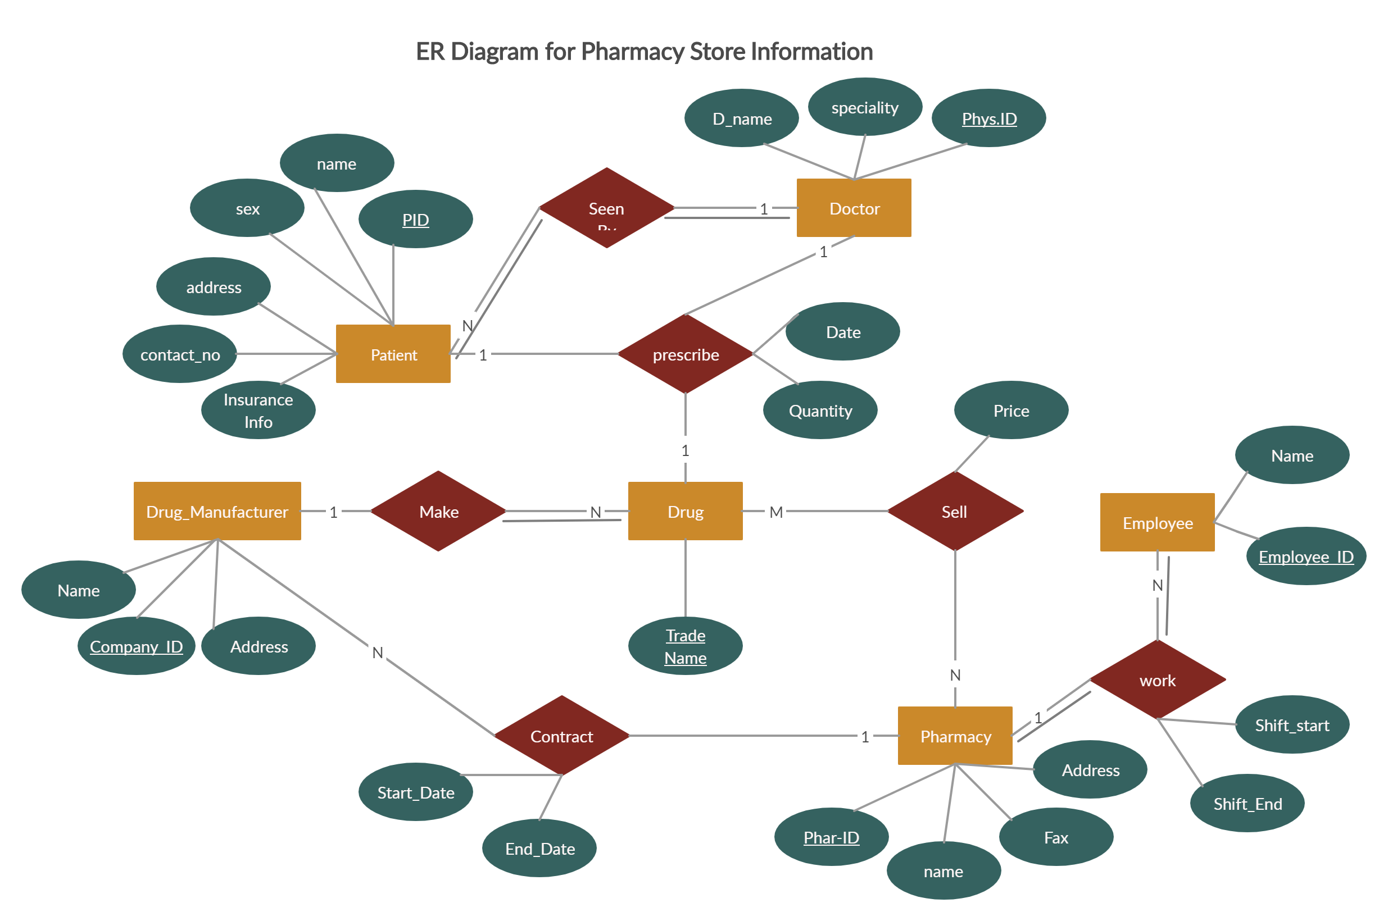

Slide 77
Class-based Modeling

Slide 78
Identifying Analysis Classes
Perform a grammatical parse of the problem statement or use cases
Classes are determined by underlining each noun or noun clause
A class required to implement a solution is part of the solution space
A class necessary only to describe a solution is part of the problem space
A class should NOT have an imperative procedural name (i.e., a verb)
List the potential class names in a table and "classify" each class according to some taxonomy and class selection characteristics
A potential class should satisfy nearly all (or all) of the selection characteristics to be considered a legitimate problem domain class
Potential classes | General classification | Selection Characteristics
(More on next slide)

Slide 79
Identifying Analysis Classes (continued)
General classifications for a potential class
External entity (e.g., another system, a device, a person)
Thing (e.g., report, screen display)
Occurrence or event (e.g., movement, completion)
Role (e.g., manager, engineer, salesperson)
Organizational unit (e.g., division, group, team)
Place (e.g., manufacturing floor, loading dock)
Structure (e.g., sensor, vehicle, computer)
(More on next slide)

Slide 80
Identifying Analysis Classes (continued)
Six class selection characteristics
Retained information
Information must be remembered about the system over time
Needed services
Set of operations that can change the attributes of a class
Multiple attributes
Whereas, a single attribute may denote an atomic variable rather than a class
Common attributes
A set of attributes apply to all instances of a class
Common operations
A set of operations apply to all instances of a class
Essential requirements
Entities that produce or consume information

Slide 81
Defining Attributes of a Class
Attributes of a class are those nouns from the grammatical parse that reasonably belong to a class
Attributes hold the values that describe the current properties or state of a class
An attribute may also appear initially as a potential class that is later rejected because of the class selection criteria
In identifying attributes, the following question should be answered
What data items (composite and/or elementary) will fully define a specific class in the context of the problem at hand?
Usually an item is not an attribute if more than one of them is to be associated with a class

Slide 82
Defining Operations of a Class
Operations define the behavior of an object
Four categories of operations
Operations that manipulate data in some way to change the state of an object (e.g., add, delete, modify)
Operations that perform a computation
Operations that inquire about the state of an object
Operations that monitor an object for the occurrence of a controlling event
An operation has knowledge about the state of a class and the nature of its associations
The action performed by an operation is based on the current values of the attributes of a class
Using a grammatical parse again, circle the verbs; then select the verbs that relate to the problem domain classes that were previously identified

Slide 83
Example Class Box
Class Name
Component
+ componentID
- telephoneNumber
- componentStatus
- delayTime
- masterPassword
- numberOfTries
Attributes
+ program()
+ display()
+ reset()
+ query()
- modify()
+ call()
Operations

Slide 84
Association, Generalization and Dependency (Ref: Fowler)
Association
Represented by a solid line between two classes directed from the source class to the target class
Used for representing (i.e., pointing to) object types for attributes
May also be a part-of relationship (i.e., aggregation), which is represented by a diamond-arrow
Generalization
Portrays inheritance between a super class and a subclass
Is represented by a line with a triangle at the target end
Dependency
A dependency exists between two elements if changes to the definition of one element (i.e., the source or supplier) may cause changes to the other element (i.e., the client)
Examples
One class calls a method of another class
One class utilizes another class as a parameter of a method

Slide 85
Example Class Diagram
Accountant
Auditor
Record
Keeper
Input Verifier
Production
Manager
Transaction
Processor
Error Log
Input Handler
Report
Generator
Account List
Account
1..n
Local File
Handler
Remote File
Handler
Accounts
Receivable
Accounts
Payable

Slide 86
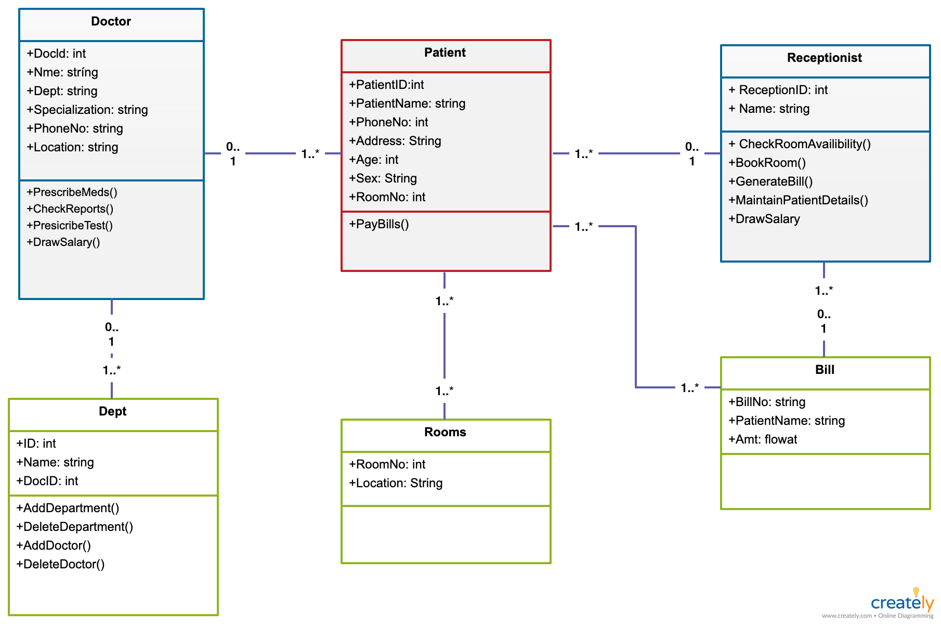

Slide 87
Flow-oriented Modeling

Slide 88
Data Modeling
Identify the following items
Data objects (Entities)
Data attributes
Relationships
Cardinality (number of occurrences)

Slide 89
Data Flow and Control Flow
Data Flow Diagram
Depicts how input is transformed into output as data objects move through a system
Process Specification
Describes data flow processing at the lowest level of refinement in the data flow diagrams
Control Flow Diagram
Illustrates how events affect the behavior of a system through the use of state diagrams

Slide 90
Diagram Layering and Process Refinement
Context-level diagram
Level 1 diagram
Process Specification

Slide 91
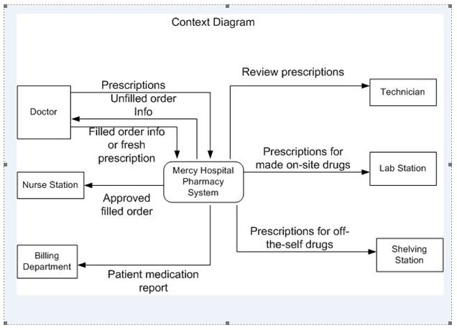

Slide 92
Behavioral Modeling

Slide 93
Creating a Behavioral Model
Identify events found within the use cases and implied by the attributes in the class diagrams
Build a state diagram for each class, and if useful, for the whole software system

Slide 94
Identifying Events in Use Cases
An event occurs whenever an actor and the system exchange information
An event is NOT the information that is exchanged, but rather the fact that information has been exchanged
Some events have an explicit impact on the flow of control, while others do not
An example is the reading of a data item from the user versus comparing the data item to some possible value

Slide 95
Building a State Diagram
A state is represented by a rounded rectangle
A transition (i.e., event) is represented by a labeled arrow leading from one state to another
Syntax: trigger-signature [guard]/activity
The active state of an object indicates the current overall status of the object as is goes through transformation or processing
A state name represents one of the possible active states of an object
The passive state of an object is the current value of all of an object's attributes
A guard in a transition may contain the checking of the passive state of an object

Slide 96
Example State Diagram
pop / set n to 0; return error
push [n – 2 < max]
push [n = 0]
Empty
Stack
Partially
Filled Stack
pop [n > 1]
pop [n = 1]
pop [n = max]
push [n - 1 = max]
Full Stack
push / set n to max; return error

Slide 97
Summary: Elements of the Analysis Model
Object-oriented Analysis
Structured Analysis
Scenario-based
modeling
Flow-oriented
modeling
Use case text
Use case diagrams
Activity diagrams
Swim lane diagrams
Data flow diagrams
Control-flow diagrams
Processing narratives
Class-based
modeling
Behavioral
modeling
Class diagrams
Analysis packages
CRC models
Collaboration diagrams
State diagrams
Sequence diagrams
☺

